Slide 1
Chapter 1
Software & Software Engineering
Slide Set to accompany Software Engineering: A Practitioner’s Approach, 7/e
by Roger S. Pressman
Slides copyright © 1996, 2001, 2005, 2009 by Roger S. Pressman
For non-profit educational use only
May be reproduced ONLY for student use at the university level when used in conjunction with Software Engineering: A Practitioner's Approach, 7/e. Any other reproduction or use is prohibited without the express written permission of the author.
All copyright information MUST appear if these slides are posted on a website for student use.
These slides are designed to accompany Software Engineering: A Practitioner’s Approach, 7/e (McGraw-Hill 2009). Slides copyright 2009 by Roger Pressman.
‹#›
Notes:
‹#›

Slide 2
What is Software?
Software is: (1) instructions (computer programs) that when executed provide desired features, function, and performance; (2) data structures that enable the programs to adequately manipulate information and (3) documentation that describes the operation and use of the programs.
These slides are designed to accompany Software Engineering: A Practitioner’s Approach, 7/e (McGraw-Hill 2009). Slides copyright 2009 by Roger Pressman.
‹#›
Notes:
‹#›

Slide 3
What is Software?
Software is developed or engineered, it is not manufactured in the classical sense.
Software doesn't "wear out."
Although the industry is moving toward component-based construction, most software continues to be custom-built.
These slides are designed to accompany Software Engineering: A Practitioner’s Approach, 7/e (McGraw-Hill 2009). Slides copyright 2009 by Roger Pressman.
‹#›

Slide 4
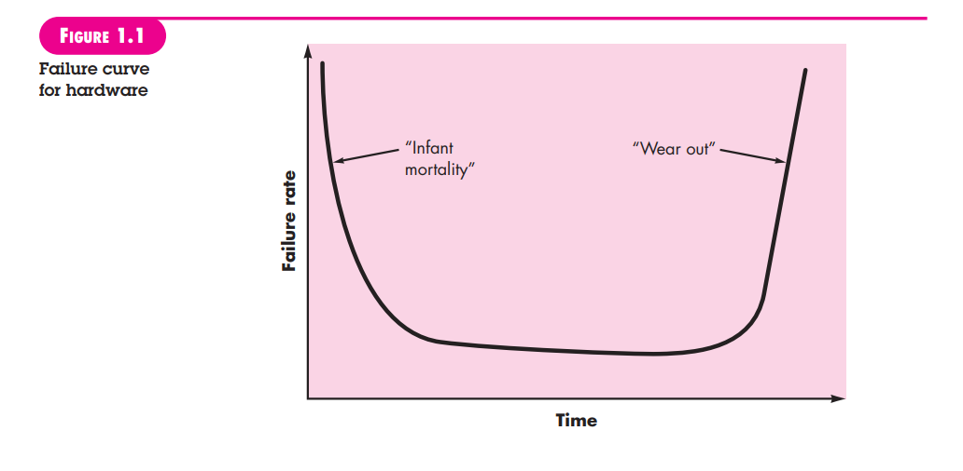
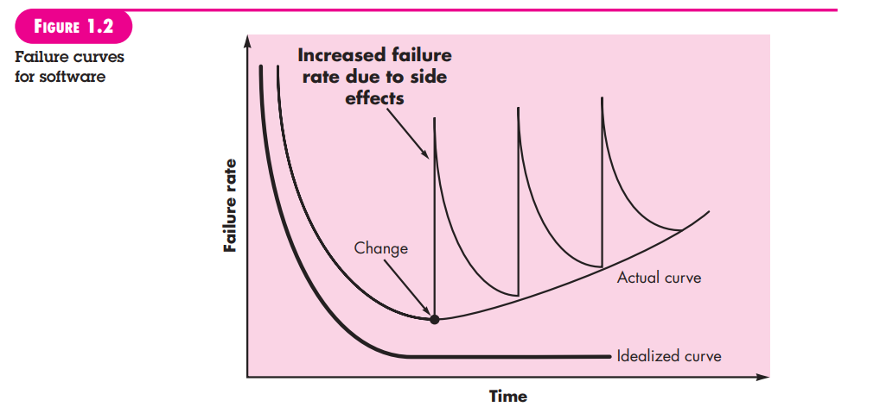
Wear vs. Deterioration
These slides are designed to accompany Software Engineering: A Practitioner’s Approach, 7/e (McGraw-Hill 2009). Slides copyright 2009 by Roger Pressman.
‹#›
Notes:
‹#›

Slide 5
Software Applications
system software
application software
engineering/scientific software
embedded software
product-line software
WebApps (Web applications)
AI software
These slides are designed to accompany Software Engineering: A Practitioner’s Approach, 7/e (McGraw-Hill 2009). Slides copyright 2009 by Roger Pressman.
‹#›
Notes:
‹#›

Slide 6
Software—New Categories
Open world computing—pervasive, distributed computing
Ubiquitous computing—wireless networks
Netsourcing—the Web as a computing engine
Open source—”free” source code open to the computing community (a blessing, but also a potential curse!)
Also … (see Chapter 31)
Data mining
Grid computing
Cognitive machines
Software for nanotechnologies
These slides are designed to accompany Software Engineering: A Practitioner’s Approach, 7/e (McGraw-Hill 2009). Slides copyright 2009 by Roger Pressman.
‹#›
Notes:
‹#›

Slide 7
Legacy Software
Why must it change?
software must be adapted to meet the needs of new computing environments or technology.
software must be enhanced to implement new business requirements.
software must be extended to make it interoperable with other more modern systems or databases.
software must be re-architected to make it viable within a network environment.
These slides are designed to accompany Software Engineering: A Practitioner’s Approach, 7/e (McGraw-Hill 2009). Slides copyright 2009 by Roger Pressman.
‹#›
Notes:
‹#›

Slide 8
Characteristics of WebApps - I
Network intensiveness. A WebApp resides on a network and must serve the needs of a diverse community of clients.
Concurrency. A large number of users may access the WebApp at one time.
Unpredictable load. The number of users of the WebApp may vary by orders of magnitude from day to day.
Performance. If a WebApp user must wait too long (for access, for server-side processing, for client-side formatting and display), he or she may decide to go elsewhere.
Availability. Although expectation of 100 percent availability is unreasonable, users of popular WebApps often demand access on a “24/7/365” basis.
These slides are designed to accompany Software Engineering: A Practitioner’s Approach, 7/e (McGraw-Hill 2009). Slides copyright 2009 by Roger Pressman.
‹#›

Slide 9
Characteristics of WebApps - II
Data driven. The primary function of many WebApps is to use hypermedia to present text, graphics, audio, and video content to the end-user.
Content sensitive. The quality and aesthetic nature of content remains an important determinant of the quality of a WebApp.
Continuous evolution. Unlike conventional application software that evolves over a series of planned, chronologically-spaced releases, Web applications evolve continuously.
Immediacy. Although immediacy—the compelling need to get software to market quickly—is a characteristic of many application domains, WebApps often exhibit a time to market that can be a matter of a few days or weeks.
Security. Because WebApps are available via network access, it is difficult, if not impossible, to limit the population of end-users who may access the application.
Aesthetics. An undeniable part of the appeal of a WebApp is its look and feel.
These slides are designed to accompany Software Engineering: A Practitioner’s Approach, 7/e (McGraw-Hill 2009). Slides copyright 2009 by Roger Pressman.
‹#›

Slide 10
Software Engineering
Some realities:
a concerted effort should be made to understand the problem before a software solution is developed
design becomes a pivotal activity
software should exhibit high quality
software should be maintainable
The seminal definition:
[Software engineering is] the establishment and use of sound engineering principles in order to obtain economically software that is reliable and works efficiently on real machines.
These slides are designed to accompany Software Engineering: A Practitioner’s Approach, 7/e (McGraw-Hill 2009). Slides copyright 2009 by Roger Pressman.
‹#›

Slide 11
Software Engineering
The IEEE definition:
Software Engineering: (1) The application of a systematic, disciplined, quantifiable approach to the development, operation, and maintenance of software; that is, the application of engineering to software. (2) The study of approaches as in (1).
These slides are designed to accompany Software Engineering: A Practitioner’s Approach, 7/e (McGraw-Hill 2009). Slides copyright 2009 by Roger Pressman.
‹#›

Slide 12
A Layered Technology
tools
methods
process model
a “quality” focus
Software Engineering
These slides are designed to accompany Software Engineering: A Practitioner’s Approach, 7/e (McGraw-Hill 2009). Slides copyright 2009 by Roger Pressman.
‹#›

Slide 13
A Process Framework
Process framework
Framework activities
work tasks
work products
milestones & deliverables
QA checkpoints
Umbrella Activities
These slides are designed to accompany Software Engineering: A Practitioner’s Approach, 7/e (McGraw-Hill 2009). Slides copyright 2009 by Roger Pressman.
‹#›

Slide 14
Framework Activities
Communication
Planning
Modeling
Analysis of requirements
Design
Construction
Code generation
Testing
Deployment
These slides are designed to accompany Software Engineering: A Practitioner’s Approach, 7/e (McGraw-Hill 2009). Slides copyright 2009 by Roger Pressman.
‹#›

Slide 15
Umbrella Activities
Software project management
Formal technical reviews
Software quality assurance
Software configuration management
Work product preparation and production
Reusability management
Measurement
Risk management
These slides are designed to accompany Software Engineering: A Practitioner’s Approach, 7/e (McGraw-Hill 2009). Slides copyright 2009 by Roger Pressman.
‹#›

Slide 16
Adapting a Process Model
the overall flow of activities, actions, and tasks and the interdependencies among them
the degree to which actions and tasks are defined within each framework activity
the degree to which work products are identified and required
the manner which quality assurance activities are applied
the manner in which project tracking and control activities are applied
the overall degree of detail and rigor with which the process is described
the degree to which the customer and other stakeholders are involved with the project
the level of autonomy given to the software team
the degree to which team organization and roles are prescribed
These slides are designed to accompany Software Engineering: A Practitioner’s Approach, 7/e (McGraw-Hill 2009). Slides copyright 2009 by Roger Pressman.
‹#›

Slide 17
The Essence of Practice
Polya suggests:
1. Understand the problem (communication and analysis).
2. Plan a solution (modeling and software design).
3. Carry out the plan (code generation).
4. Examine the result for accuracy (testing and quality assurance).
These slides are designed to accompany Software Engineering: A Practitioner’s Approach, 7/e (McGraw-Hill 2009). Slides copyright 2009 by Roger Pressman.
‹#›

Slide 18
Understand the Problem
Who has a stake in the solution to the problem? That is, who are the stakeholders?
What are the unknowns? What data, functions, and features are required to properly solve the problem?
Can the problem be compartmentalized? Is it possible to represent smaller problems that may be easier to understand?
Can the problem be represented graphically? Can an analysis model be created?
These slides are designed to accompany Software Engineering: A Practitioner’s Approach, 7/e (McGraw-Hill 2009). Slides copyright 2009 by Roger Pressman.
‹#›

Slide 19
Plan the Solution
Have you seen similar problems before? Are there patterns that are recognizable in a potential solution? Is there existing software that implements the data, functions, and features that are required?
Has a similar problem been solved? If so, are elements of the solution reusable?
Can subproblems be defined? If so, are solutions readily apparent for the subproblems?
Can you represent a solution in a manner that leads to effective implementation? Can a design model be created?
These slides are designed to accompany Software Engineering: A Practitioner’s Approach, 7/e (McGraw-Hill 2009). Slides copyright 2009 by Roger Pressman.
‹#›

Slide 20
Carry Out the Plan
Does the solution conform to the plan? Is source code traceable to the design model?
Is each component part of the solution provably correct? Has the design and code been reviewed, or better, have correctness proofs been applied to algorithm?
These slides are designed to accompany Software Engineering: A Practitioner’s Approach, 7/e (McGraw-Hill 2009). Slides copyright 2009 by Roger Pressman.
‹#›

Slide 21
Examine the Result
Is it possible to test each component part of the solution? Has a reasonable testing strategy been implemented?
Does the solution produce results that conform to the data, functions, and features that are required? Has the software been validated against all stakeholder requirements?
These slides are designed to accompany Software Engineering: A Practitioner’s Approach, 7/e (McGraw-Hill 2009). Slides copyright 2009 by Roger Pressman.
‹#›

Slide 22
Hooker’s General Principles
1: The Reason It All Exists
2: KISS (Keep It Simple, Stupid!)
3: Maintain the Vision
4: What You Produce, Others Will Consume
5: Be Open to the Future
6: Plan Ahead for Reuse
7: Think!
These slides are designed to accompany Software Engineering: A Practitioner’s Approach, 7/e (McGraw-Hill 2009). Slides copyright 2009 by Roger Pressman.
‹#›

Slide 23
Software Myths
Affect managers, customers (and other non-technical stakeholders) and practitioners
Are believable because they often have elements of truth,
but …
Invariably lead to bad decisions,
therefore …
Insist on reality as you navigate your way through software engineering
These slides are designed to accompany Software Engineering: A Practitioner’s Approach, 7/e (McGraw-Hill 2009). Slides copyright 2009 by Roger Pressman.
‹#›
Notes:
‹#›

Slide 24
How It all Starts
SafeHome:
Every software project is precipitated by some business need—
the need to correct a defect in an existing application;
the need to the need to adapt a ‘legacy system’ to a changing business environment;
the need to extend the functions and features of an existing application, or
the need to create a new product, service, or system.
These slides are designed to accompany Software Engineering: A Practitioner’s Approach, 7/e (McGraw-Hill 2009). Slides copyright 2009 by Roger Pressman.
‹#›
Notes:
‹#›

